Slide 1
Presentation
On
Transmitter of Basic Monochrome Television System

Slide 2
Submited To:
Md. Imran Hossain
Assistant Professor
Department of ICT
Comilla University
Submited By:
Arpita Saha
ID: 11809035
Session: 2017-18
Department of ICT
Comilla University

Slide 3
What is Monochrome Television?
“Mono” = One & “Chrome” = Color
Television in which the final reproduced picture is having only shades of gray between black and white.
Also known as black-and-white television.

Slide 4
What is Television Transmitter?
An electric device that converts audio and video signals into modulated radio frequency energy which can be radiated from an antenna and received by a television.

Slide 5
Basics of Monochrome TV Transmitter
A large amount of information must be broadcast by a television transmitter.
Ideally, there are video details or informations in optical domain.
In TV transmitter both picture and sound are transmitted. AM modulation is used for video & FM modulation is used for audio.

Slide 6
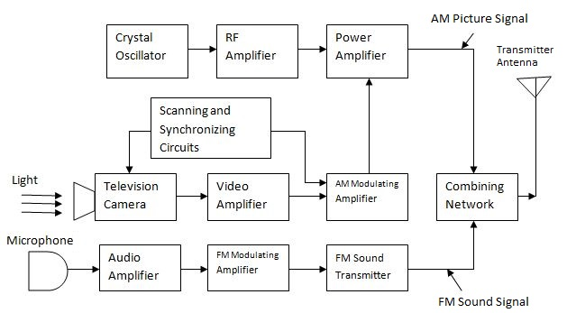

Slide 7
Monochrome TV Transmitter
There are two sections: Video Sections & Audio Sections
Video sections consists of camera tube, video amplifiers, AM modulating amplifiers & scanning and synchronizing circuits.
Audio sections consists of microphone, FM modulating amplifier and sound transmitter.

Slide 8
Parameters of Monochrome TV Transmitter
It has a video information, in between black & white with the shades of grey.
Its transmits on channels in the VHF and UHF.
Picture and sound signals are modulated in RF carrier to reduce the antenna size.

Slide 9

THANK YOU
FOR
WATCHING!

